Slide 1
The Web

Slide 2
The World Wide Web
World Wide Web
The Web (originally called the World Wide Web, thus the “www” in site addresses) is just one of the ways information can be shared over the Internet.
The WWW is not the same as the Internet, but rather a part of the internet. There are other services such as email, apps, file backups, instant messaging etc.

Slide 3
WWW Terminology
Home page
The cover page for a Web site that has graphics, titles, coloured text, etc.
Hypermedia
Tools that connect the data on Web pages, allowing users to access topics in whatever order they wish
Hypertext markup language (HTML)
The standard page description language for Web pages

Slide 4
WWW Terminology
Web browser
Software that creates a unique hypermedia-based menu on your computer screen and provides a graphical interface to the Web
Web page
A screen of information sent to a requesting user and presented through a browser
Applet
A small program embedded in Web pages

Slide 5
Servers
The role of server software is to wait for a request for information, then retrieve and send that information back as quickly as possible.
There’s nothing special about the computers themselves…picture anything from a high-powered Unix machine to a humble personal computer. It’s the server software that makes it all happen. In order for a computer to be part of the Web, it must be running special web server software that allows it to handle Hypertext Transfer Protocol transactions. Web servers are also called “HTTP servers.”
There are many server software options out there, but the two most popular are Apache (open source software) and Microsoft Internet Information Services (IIS). Apache is freely available for Unix-based computers and comes installed on Macs running Mac OS X. There is a Windows version as well. Microsoft IIS is part of Microsoft’s family of server solutions.

Slide 6
Clients
The software that does the requesting is called the client. People use browsers including the Internet Explorer for Windows, Chrome, Firefox, Safari and Opera.
Clients request pages from servers.

Slide 7
Server-side and Client-side
These terms are used to indicate which machine is doing the processing. Client-side applications run on the user’s machine, while server-side applications and functions use the processing power of the server computer.

Slide 8

A URL is a Uniform Resource Locator
Anatomy of a URL
protocol
host computer
directory path
file name
Note: Not all URLs will have the directory and filename

Slide 9
Assumed names
HTTP
If you forget to type “http” at the front of a URL, the computer will add it for you automatically.
Index.htm or index.html or default.html
Many addresses do not include a filename, but simply point to a directory, like these:
http://www.oreilly.com
http://www.jendesign.com/resume/
When a server receives a request for a directory name rather than a specific file, it looks in that directory for a default document, typically named index.html. So when someone types the above URLs into their browser, what they’ll actually see is this:
http://www.oreilly.com/index.html
http://www.jendesign.com/resume/index.html

Slide 10
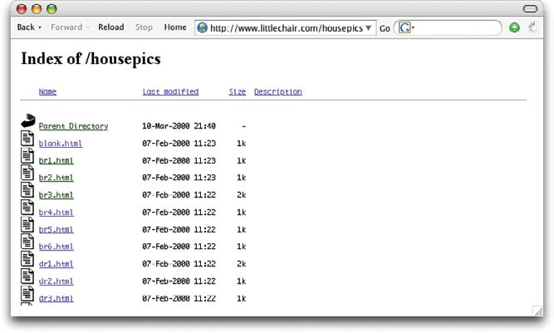
The missing index.html file
What if you forget to create an index.html file in a folder on the server? The server might display a list of files in that directory, which might not be what you want.

Slide 11
HTML, CSS and JavaScript
The three building blocks of most web pages.
HTML – Hypertext Markup Language
CSS – Cascading Style Sheets
JavaScript – Programming language to perform actions.

Slide 12
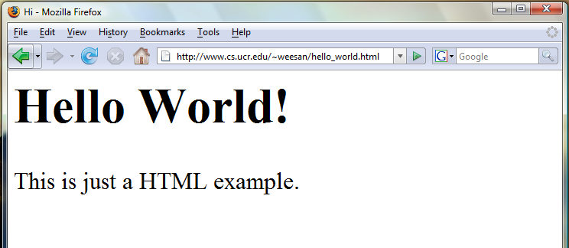
HTML Example
<html>
<head><title>Hi</title></head>
<body>
<h1>Hello World!</h1>
This is just a HTML
example.
</body>
</html>

Slide 13
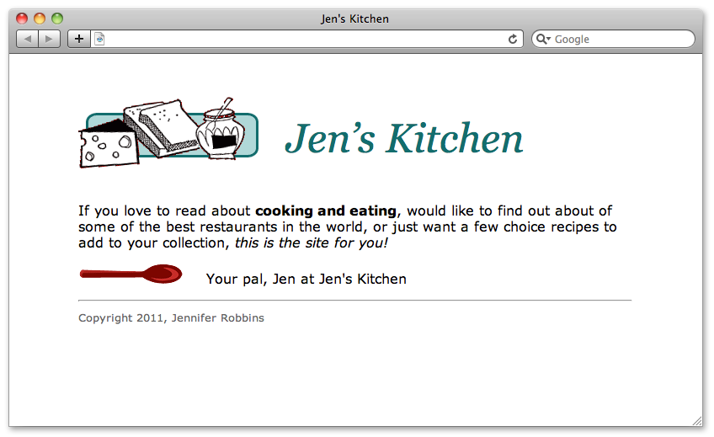
Source files of a page
You can see the HTML file for any web page by choosing View ➝Page Source or (View ➝ Source) in your browser’s menu.
Enter this URL into your browser.
www.learningwebdesign.com/4e/materials/chapter02/kitchen.html

Slide 14
Some HTML tags
<!DOCTYPE html>
Tells the client that this is an HTML document. Every web page should start with this tag.
<!DOCTYPE html>
<html>
<head>
<title>Jen's Kitchen</title>
<link rel="stylesheet" href="kitchen.css">
</head>
<body>
<h1><img src="foods.gif" alt="food illustration"> Jen&rsquo;s Kitchen</h1>
<p>If you love to read about <strong>cooking and eating</strong>, would like to find out about of some of the best restaurants in the world, or just want a few choice recipes to add to your collection, <em>this is the site for you!</em></p>
<p><img src="spoon.gif" alt="spoon illustration"> Your pal, Jen at Jen's Kitchen</p>
<hr>
<small>Copyright 2011, Jennifer Robbins</small>
</body>
</html>

Slide 15
Some HTML tags
<html>
This is the starting point of the HTML code on the page. Notice that the end of the page has the closing tag </html>
<!DOCTYPE html>
<html>
<head>
<title>Jen's Kitchen</title>
<link rel="stylesheet" href="kitchen.css">
</head>
<body>
<h1><img src="foods.gif" alt="food illustration"> Jen&rsquo;s Kitchen</h1>
<p>If you love to read about <strong>cooking and eating</strong>, would like to find out about of some of the best restaurants in the world, or just want a few choice recipes to add to your collection, <em>this is the site for you!</em></p>
<p><img src="spoon.gif" alt="spoon illustration"> Your pal, Jen at Jen's Kitchen</p>
<hr>
<small>Copyright 2011, Jennifer Robbins</small>
</body>
</html>

Slide 16
Some HTML tags
<head>
The page head has the title that shows in the title of the client’s browser application. Notice that the end of the head has the closing tag </head>
<!DOCTYPE html>
<html>
<head>
<title>Jen's Kitchen</title>
<link rel="stylesheet" href="kitchen.css">
</head>
<body>
<h1><img src="foods.gif" alt="food illustration"> Jen&rsquo;s Kitchen</h1>
<p>If you love to read about <strong>cooking and eating</strong>, would like to find out about of some of the best restaurants in the world, or just want a few choice recipes to add to your collection, <em>this is the site for you!</em></p>
<p><img src="spoon.gif" alt="spoon illustration"> Your pal, Jen at Jen's Kitchen</p>
<hr>
<small>Copyright 2011, Jennifer Robbins</small>
</body>
</html>

Slide 17
Some HTML tags
<body>
The body of the page contains the majority of the page contents.
</body>
<!DOCTYPE html>
<html>
<head>
<title>Jen's Kitchen</title>
<link rel="stylesheet" href="kitchen.css">
</head>
<body>
<h1><img src="foods.gif" alt="food illustration"> Jen&rsquo;s Kitchen</h1>
<p>If you love to read about <strong>cooking and eating</strong>, would like to find out about of some of the best restaurants in the world, or just want a few choice recipes to add to your collection, <em>this is the site for you!</em></p>
<p><img src="spoon.gif" alt="spoon illustration"> Your pal, Jen at Jen's Kitchen</p>
<hr>
<small>Copyright 2011, Jennifer Robbins</small>
</body>
</html>

Slide 18
Some HTML tags
<h1>
Headlines have <h1> <h2> and <h3> tags. The text is larger and bold.
</h1>
<!DOCTYPE html>
<html>
<head>
<title>Jen's Kitchen</title>
<link rel="stylesheet" href="kitchen.css">
</head>
<body>
<h1><img src="foods.gif" alt="food illustration"> Jen&rsquo;s Kitchen</h1>
<p>If you love to read about <strong>cooking and eating</strong>, would like to find out about of some of the best restaurants in the world, or just want a few choice recipes to add to your collection, <em>this is the site for you!</em></p>
<p><img src="spoon.gif" alt="spoon illustration"> Your pal, Jen at Jen's Kitchen</p>
<hr>
<small>Copyright 2011, Jennifer Robbins</small>
</body>
</html>

Slide 19
Some HTML tags
<img src=“foods.gif">
Pictures are saved separately from the HTML document.
</img>
<!DOCTYPE html>
<html>
<head>
<title>Jen's Kitchen</title>
<link rel="stylesheet" href="kitchen.css">
</head>
<body>
<h1><img src="foods.gif" alt="food illustration"> Jen&rsquo;s Kitchen</h1>
<p>If you love to read about <strong>cooking and eating</strong>, would like to find out about of some of the best restaurants in the world, or just want a few choice recipes to add to your collection, <em>this is the site for you!</em></p>
<p><img src="spoon.gif" alt="spoon illustration"> Your pal, Jen at Jen's Kitchen</p>
<hr>
<small>Copyright 2011, Jennifer Robbins</small>
</body>
</html>

Slide 20
Some HTML tags
<p>
Paragraphs.
</p>
<!DOCTYPE html>
<html>
<head>
<title>Jen's Kitchen</title>
<link rel="stylesheet" href="kitchen.css">
</head>
<body>
<h1><img src="foods.gif" alt="food illustration"> Jen&rsquo;s Kitchen</h1>
<p>If you love to read about <strong>cooking and eating</strong>, would like to find out about of some of the best restaurants in the world, or just want a few choice recipes to add to your collection, <em>this is the site for you!</em></p>
<p><img src="spoon.gif" alt="spoon illustration"> Your pal, Jen at Jen's Kitchen</p>
<hr>
<small>Copyright 2011, Jennifer Robbins</small>
</body>
</html>

Slide 21
Some HTML tags
<em>
Emphasis on this text (italics).
</em>
<!DOCTYPE html>
<html>
<head>
<title>Jen's Kitchen</title>
<link rel="stylesheet" href="kitchen.css">
</head>
<body>
<h1><img src="foods.gif" alt="food illustration"> Jen&rsquo;s Kitchen</h1>
<p>If you love to read about <strong>cooking and eating</strong>, would like to find out about of some of the best restaurants in the world, or just want a few choice recipes to add to your collection, <em>this is the site for you! </em></p>
<p><img src="spoon.gif" alt="spoon illustration"> Your pal, Jen at Jen's Kitchen</p>
<hr>
<small>Copyright 2011, Jennifer Robbins</small>
</body>
</html>

Slide 22
Some HTML tags
<hr>
Horizontal rule line
<!DOCTYPE html>
<html>
<head>
<title>Jen's Kitchen</title>
<link rel="stylesheet" href="kitchen.css">
</head>
<body>
<h1><img src="foods.gif" alt="food illustration"> Jen&rsquo;s Kitchen</h1>
<p>If you love to read about <strong>cooking and eating</strong>, would like to find out about of some of the best restaurants in the world, or just want a few choice recipes to add to your collection, <em>this is the site for you!</em></p>
<p><img src="spoon.gif" alt="spoon illustration"> Your pal, Jen at Jen's Kitchen</p>
<hr>
<small>Copyright 2011, Jennifer Robbins</small>
</body>
</html>

Slide 23
Some HTML tags
<link rel="stylesheet" href="kitchen.css">
Is a link to another file that defines the styles of the text.
<!DOCTYPE html>
<html>
<head>
<title>Jen's Kitchen</title>
<link rel="stylesheet" href="kitchen.css">
</head>
<body>
<h1><img src="foods.gif" alt="food illustration"> Jen&rsquo;s Kitchen</h1>
<p>If you love to read about <strong>cooking and eating</strong>, would like to find out about of some of the best restaurants in the world, or just want a few choice recipes to add to your collection, <em>this is the site for you!</em></p>
<p><img src="spoon.gif" alt="spoon illustration"> Your pal, Jen at Jen's Kitchen</p>
<hr>
<small>Copyright 2011, Jennifer Robbins</small>
</body>
</html>

Slide 24
CSS for Jen’s Kitchen…
Each section modifies the style of the letters – colors, font, size, spaces etc.
body {
font: normal 1em Verdana;
width: 80%;
margin: 1em auto;
}
h1 {
font: italic 3em Georgia;
color: rgb(23, 109, 109);
margin: 1em 0 1em;
}
img {
margin: 0 20px 0 0;
}
h1 img {
margin-bottom: -20px;
}
small {
color: #666666;
}

Slide 25
JavaScript for Jen’s Kitchen
Jen’s Kitchen doesn’t have any JavaScript code.
It is a static web page.

Slide 26
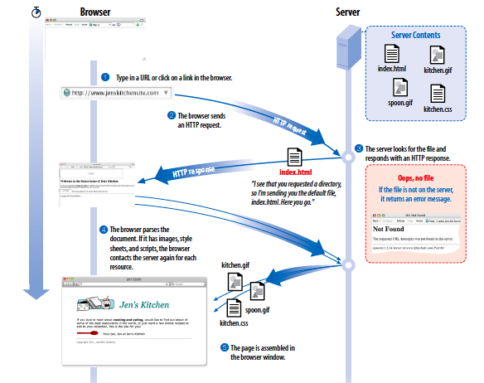

Slide 27
Your turn…
Choose a simple web page and examine it’s source. You should see HTML and CSS tags.
Wikipedia articles
https://en.wikipedia.org/wiki/Football
School Web page
http://www.tuhsd.org/

